Slide 1
Digital Security and Forensics AICT006-4-2-DSF Version 1
Introduction and Overview

Slide 2
Lecturer Information (Lecture)
Lecturer Name: Reshiwaran Jegatheswaran
Email: reshiwaran@staffemail.apu.edu.my

Slide 3
Pre-requisites for this module
None

Slide 4
Synopsis
This module is an introduction to a range of technologies associated with computer security and digital forensics.
It will expose students to tools and mechanisms in achieving an ideal information security environment.
Some of the content is mapped to CompTIA Security+ certification to provide knowledge on industry-relevant technologies and practices.
Students will also be guided to perform digital forensics investigations following the correct methodology and process.

Slide 5
Course Learning outcomes, CLOs
At the end of this course, YOU should be able to:
Discuss security and forensic techniques and technologies in different scenarios.
Identify the existence of vulnerabilities in the given virtual machine using appropriate tools.
Propose appropriate solutions to patch the vulnerabilities.
Prepare forensic image file of Random Access Memory (RAM) and Hard Disk Drive (HDD) of the given virtual machine.
CLO - Course Learning Outcomes
PLO - Programme Learning Outcomes

Slide 6
Mapping of CLOs with MOEs Domain
PLO1 - Knowledge and Understanding
PLO4 - Interpersonal Skill
PLO5 - Communication skill
PLO6 - Digital Skills

Slide 7
Teaching Strategies
Lecture
Tutorial
Case Study (Individual and Group)

Slide 8
Assessment Methods
Final Exam (40%): CLO1
Group Assignment & Individual, Presentation (60%)
Appraise Security issues
Propose solutions
Presentation

Slide 9
Student Learning Time (SLT)
Course Credit Value: 4
Total Learning Hours:
Lecture: 28 hours per semester
Tutorial / Case Study : 28 hours per semester

Slide 10
Course Content Outline
Lecture
Tutorial / Assignment
Security Concepts
Malicious Code
Cybersecurity Threats Landscape
Social Engineering, Physical and Password Attacks
Cryptography & PKI
Vulnerability Assessment and Testing
Identity and Access Management
Incidents Respond
Security Policies, Standards, and Compliance
Data Acquisition and Data Recovery
Risk Management and Privacy
Data Hiding and Obfuscation
Digital Forensics
Forensic Tools and Techniques

Slide 11
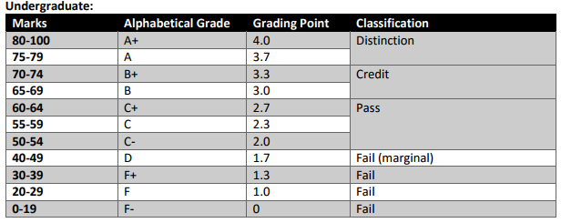
Achievement requirements

Slide 12
What is expected of you
What is expected of you
You should abide by all the rules & regulations of APU
Proper attire
No speaking of dialects
Attendance is compulsory and valid medical certificates or letters from parents /guardians must support any absence from class.
Three lateness will be equal to one absence
All pagers and handphones should be turned off during lectures.

Slide 13
What is expected of you
What is expected of you
Additional do and don’ts due during Online Digital Learning (ODL) Session:
Join the session on time (Meeting list will be downloaded at any time after 15mins session start if join after 15mins without any reason attendance mark as late).
Attendance – automatically / manually.
Mute your mic – when not in use.
Q & A session please use your mic instead of meeting chat.
Participate / engage in the teaching and learning session.

Slide 14
What support is available for you
Consultation hours (Refer to the i-consult system)
Resources
Tutorials Materials
MS Teams announcement
Moodle
Reference material
Essential Reading
Chapple, M., Seidl, D. (2021). CompTIA Security+ Study Guide: Exam SY0-601. 8th ed. John Wiley & Sons. USA. ISBN: 978-1119736257
Nelson, B., Philips, A. and Steuart, C. (2019) Guide To Computer Forensics and Investigations - Standalone Book. 6th ed. Cengage. USA. ISBN: 978-1337568944
Introduction to security and network forensics Technologies, William J. Buchanan 2011, CRC Press ISBN 9780849335686
Internet resources

Slide 15


And when you need a shoulder to cry on When you need a friend to rely on When the whole world is gone You won't be alone, cause I'll be here
I'll be your shoulder to cry on I'll be here I'll be a friend to rely on When the whole world is gone You won't be alone, cause I'll be here
from the album Tommy Page (1988)

Slide 16
Question and answer session
Q & A

Slide 17
What we will cover next
Week 1
Introduction to Security Concepts

